Slide 1
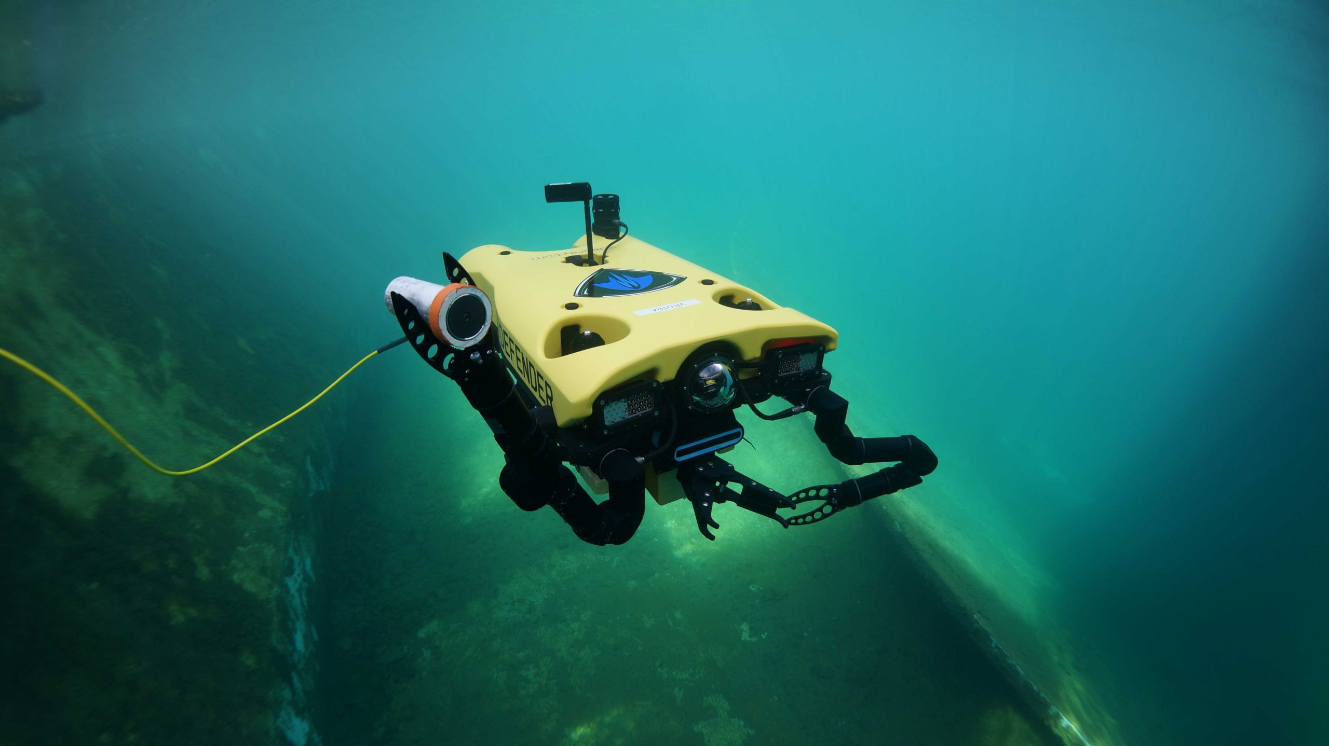
ON DEMAND INFLATION SYSTEM FOR UNDERWATER SENSOR DEPLOYMENT
NAME: P.A. SENEVIRATNE
INDEX: 14376
SUPERVISOR: DR. LAKMAL WEERAWARNE

Slide 2
Objective
Creation of an On Demand Inflation System for Underwater Sensor Deployment capable of remote data transfer which is cost effective, compact and power efficient.
MOTIVE
To assist the user in collecting data when required from deep water bodies remotely and continuously without having to be physically present.
Notes:
Stress that data would be collected by an autonomous drone
Talk about other products in the market
Transition from the objective to the motive

Slide 3
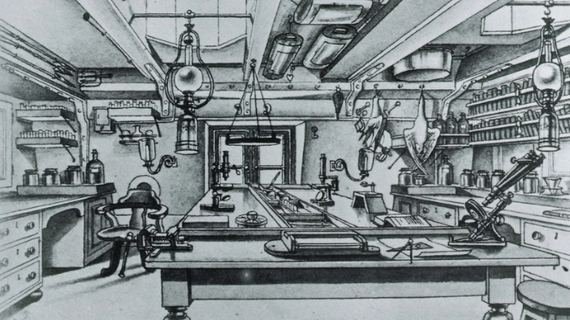
BACKGROUND
Classic methods of Scientific Oceanography study
Started in the 1800’s with the launch of the HMS challenger
Spearheaded by American and European expeditions
Data collected included depth of the ocean, samples of the sea floor and water temperatures
Laboratory on board the HMS Challenger.
Source: https://www.bbc.com/travel/article/20200719-hms-challenger-the-voyage-that-birthed-oceanography
Notes:
3 main stages of scientific oceanography study

Slide 4
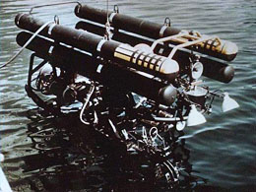
BACKGROUND
Modern methods of Scientific Oceanography study
Started in the 1960’s with numerous technological leaps
Creation of multibeam sounding for accurate ocean mapping
Creation of first deep sea submersible device
Creation of first cable controlled underwater robot
First underwater robot deployed.
Source: http://www.seasky.org/ocean-exploration/ocean-timeline-1951-1970.html

Slide 5
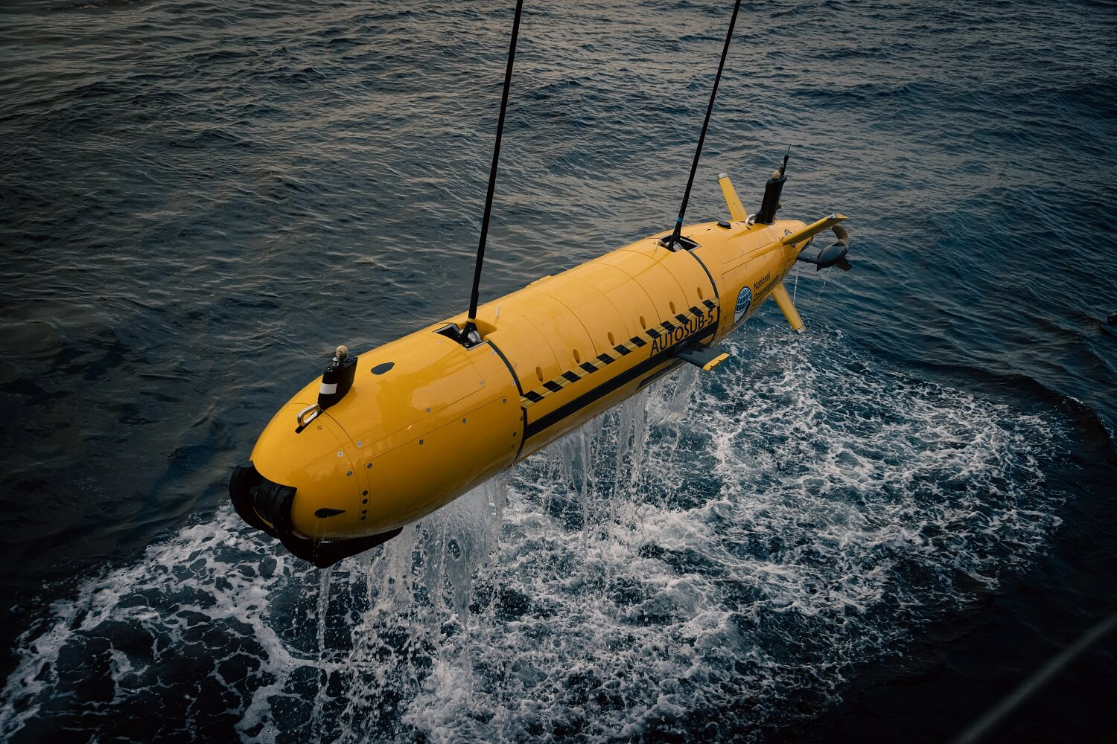
BACKGROUND
Current methods of Scientific Oceanography study
Use of newer unmanned systems
Process of completely mapping the sea floor using ships outfitted with advanced multibeam bathymetry technology
Introduction of Project Argo
“Autosub” Automated Underwater Vehicle
Source: https://www.bbc.com/travel/article/20200719-hms-challenger-the-voyage-that-birthed-oceanography
Notes:
Unmanned systems explained in depth
Argo is 3000 robotic probes throughout the worlds oceans
Done by uni of san diego california

Slide 6
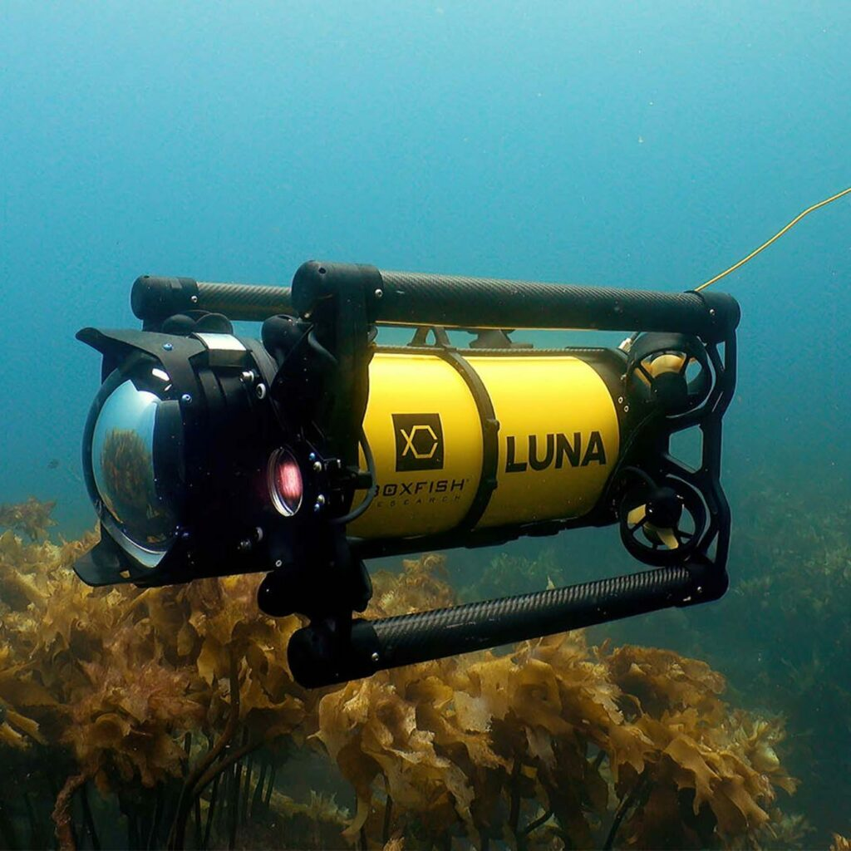
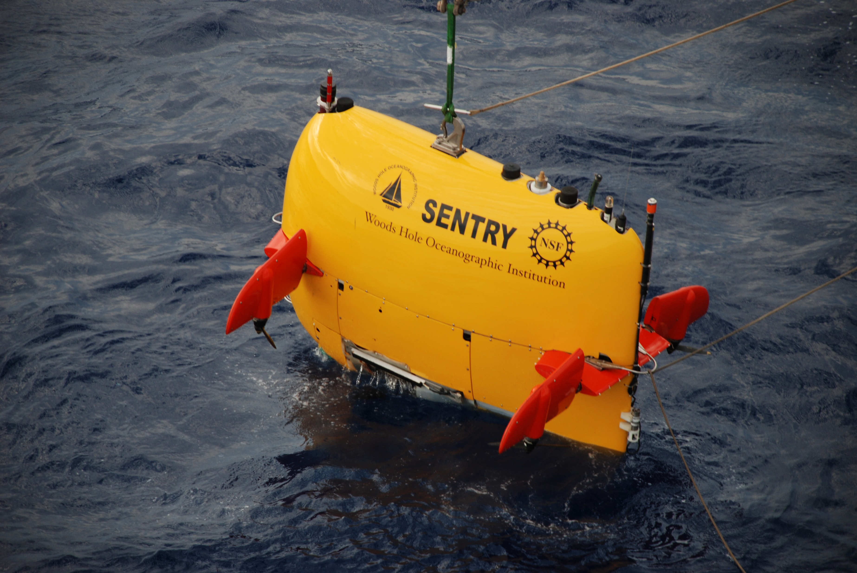
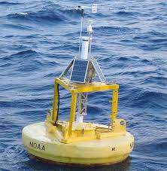
Current data collection methods
Currently used methods of data collection in deep water bodies are by Autonomous Underwater Vehicles, Buoys, Fishing Vessels and Remotely Operated Vehicles
Autonomous Underwater Vehicle
Remoted Operating Vehicle
Buoy
Notes:
Capable of obtaining data autonomously
Operate without supervision
Some cant transmit data
Some cant be controlled
Cant go to specific locations

Slide 7
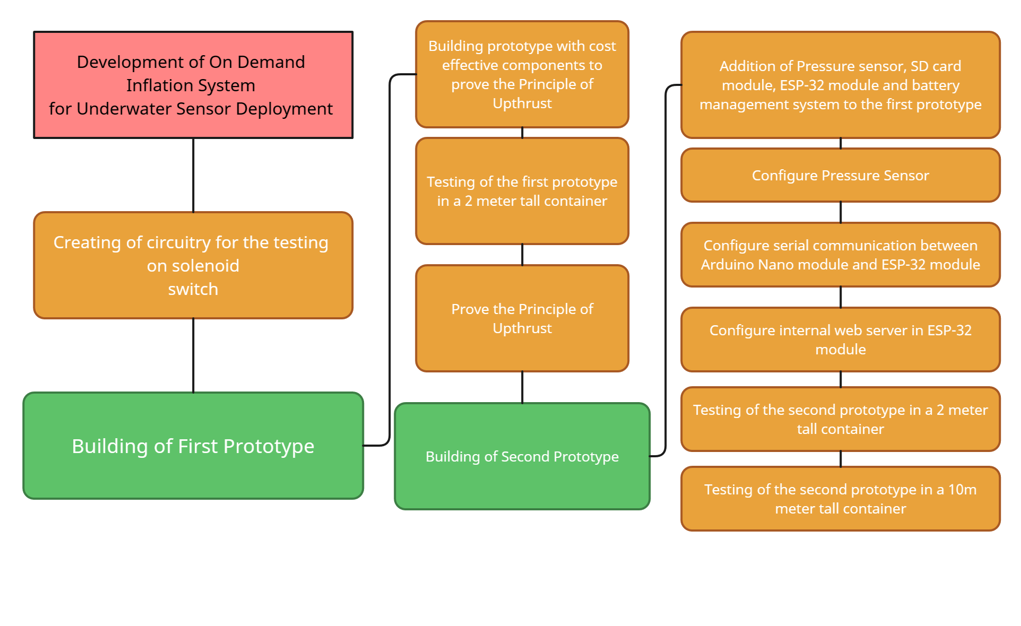
General Design flow

Slide 8
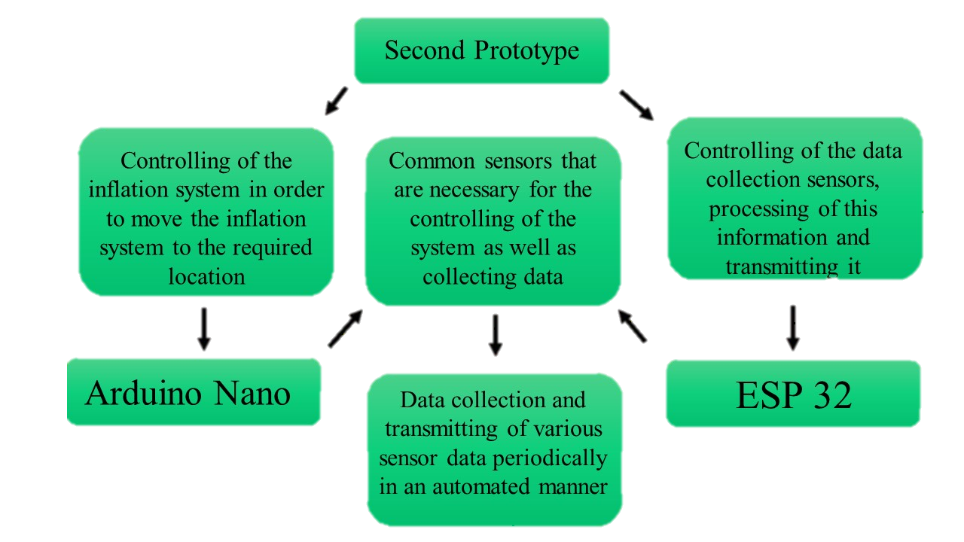
Design flow – 2nd prototype

Slide 9
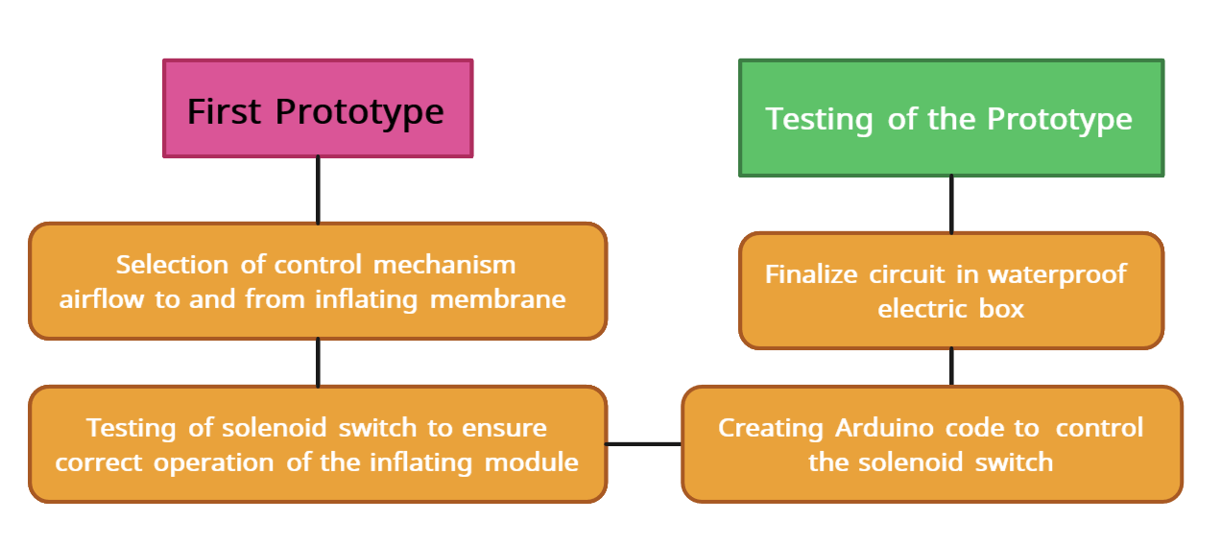
Methodology – 1st prototype
First Prototype was created with the intention of proving the principle of Upthrust could be used to move the inflation system along the vertical axis of the water. Device was put into a 2m deep water container

Slide 10
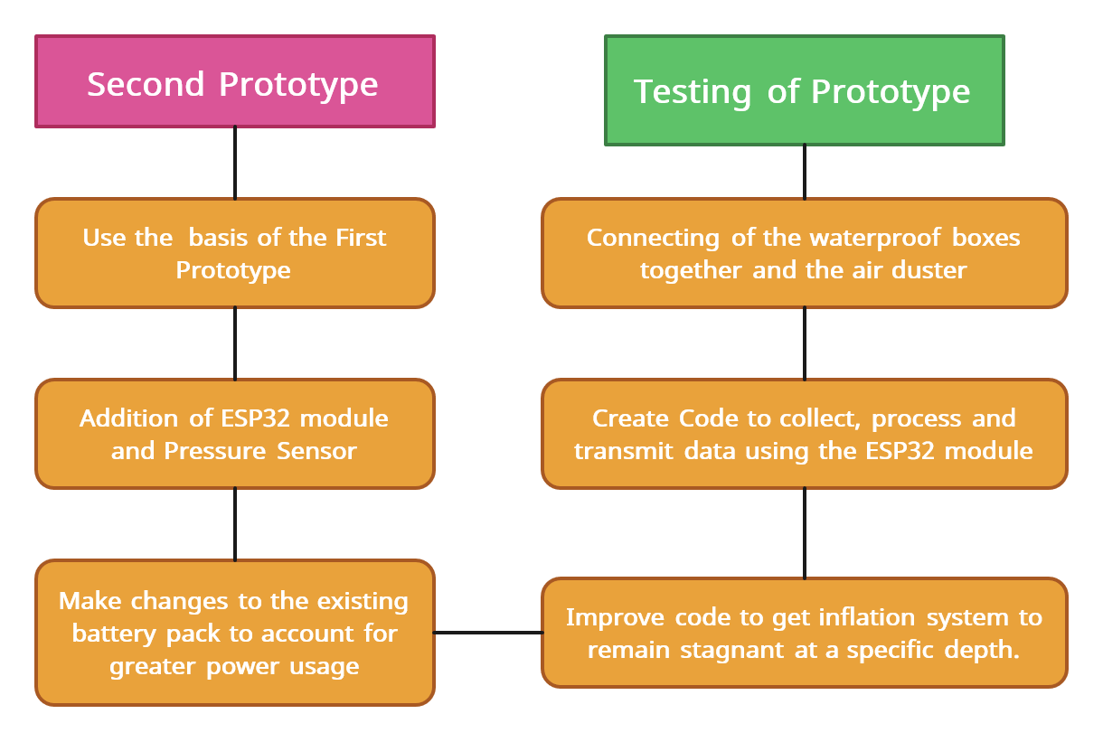
Methodology – 2nd prototype
Creation of a second prototype was built upon the first prototype with additional peripherals and data collection components added to it.
Notes:
The range of stagnation was plus or minus 0.25m due to the error of the pressure sensor.

Slide 11
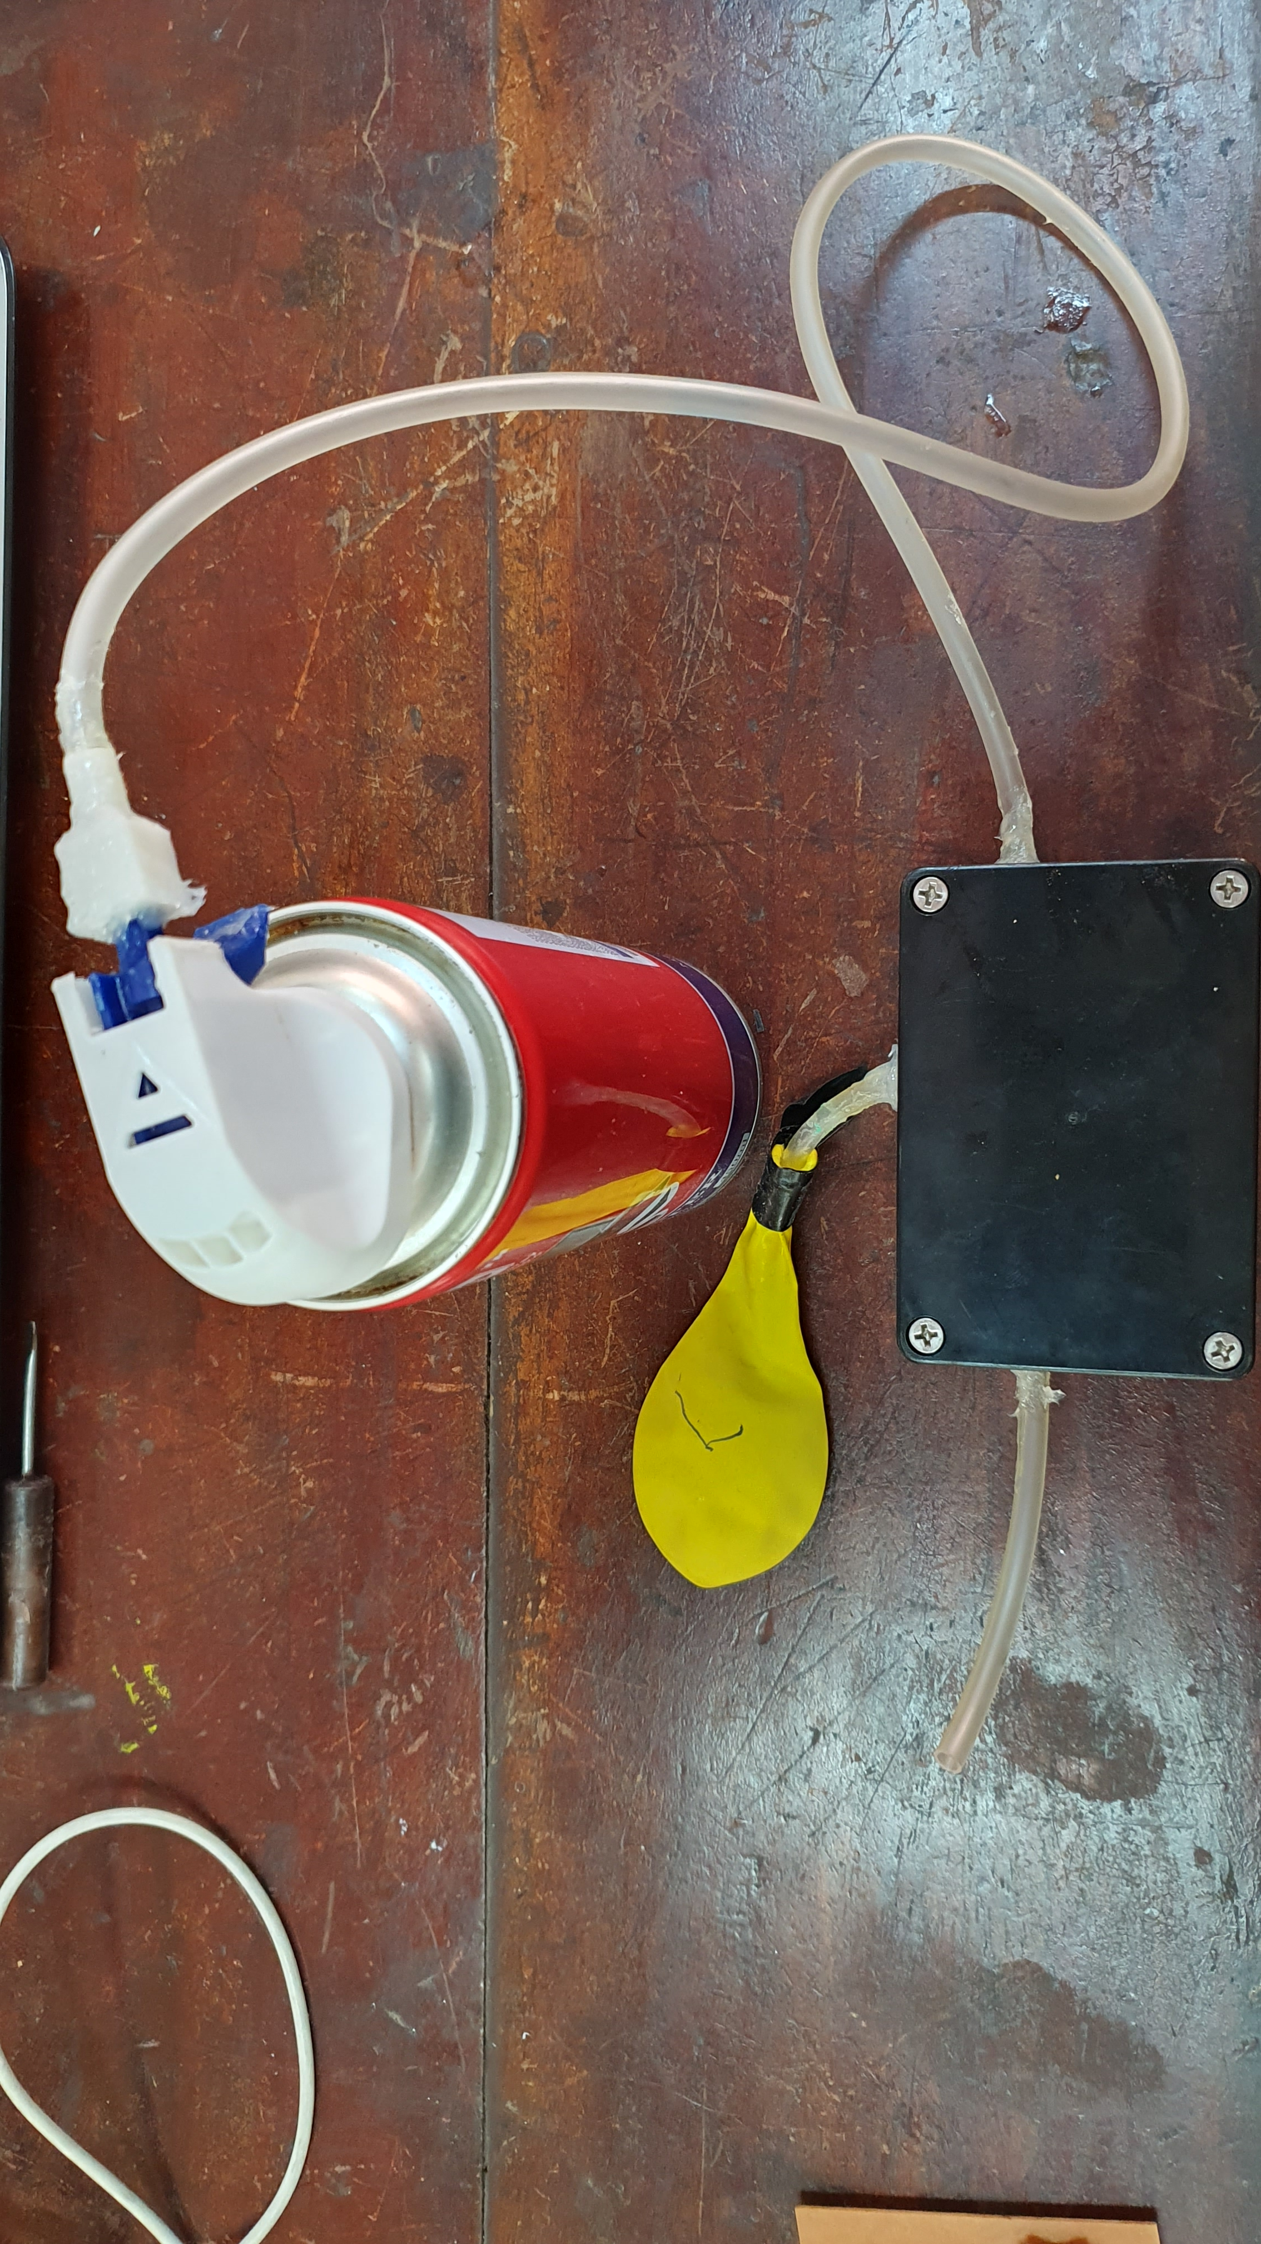
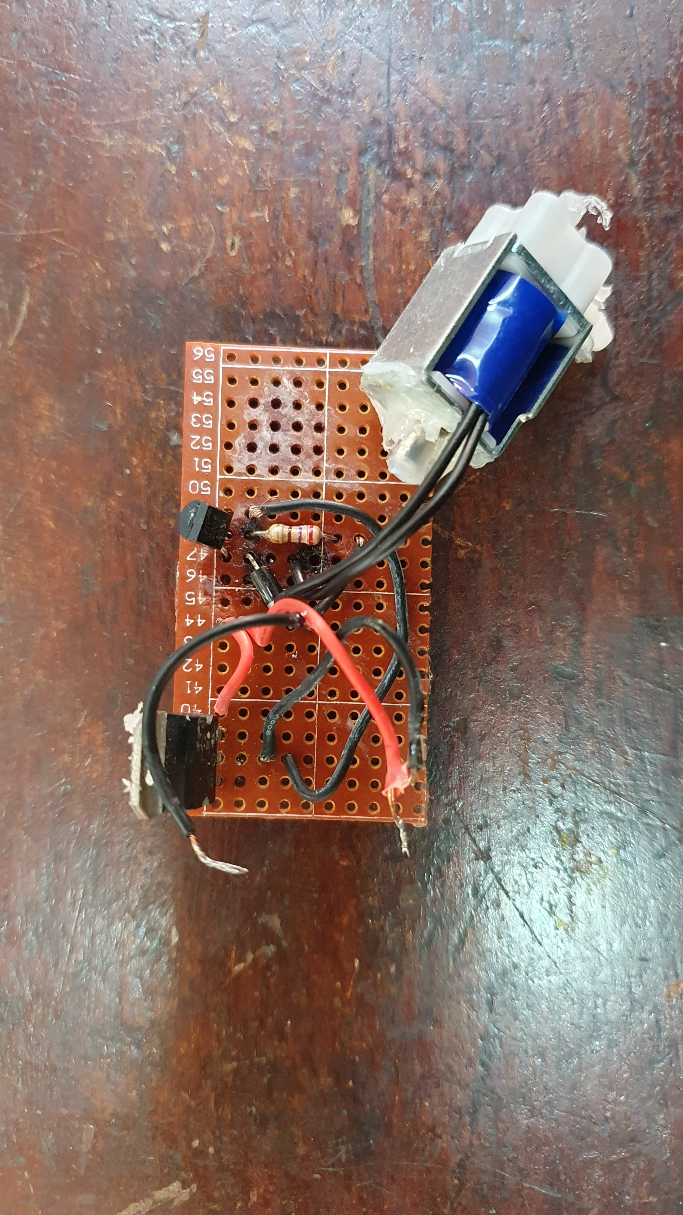
Implementation – 1st prototype
Protection Circuitry
Air Duster
Inflating Membrane
Solenoid Switch
Enclosure Box

Slide 12
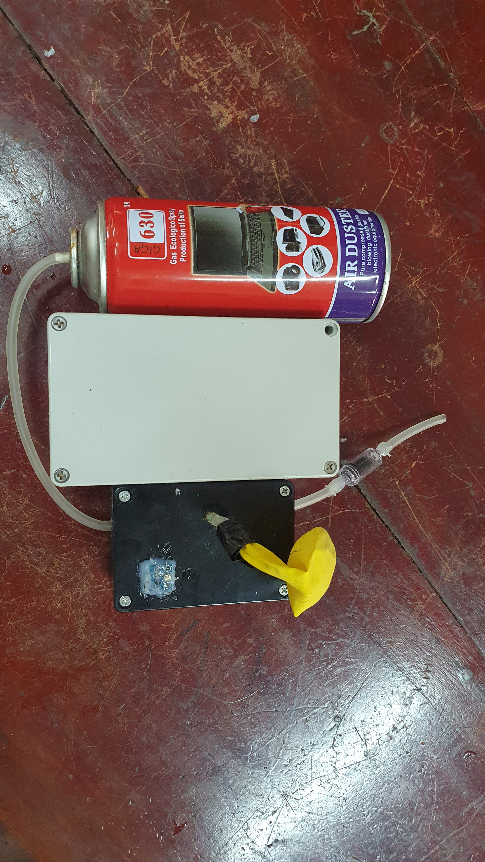
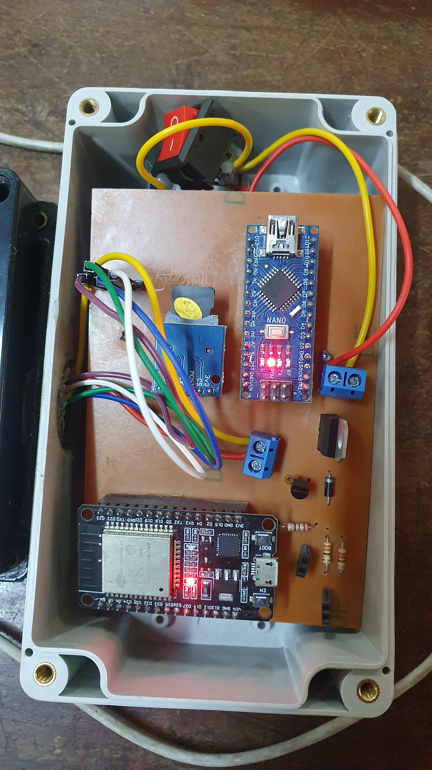
Implementation – 2nd prototype
SD card module
Arduino Nano
ESP - 32
Pressure Sensor
One way Valve

Slide 13
Analysis AND DISCUSSION – 1st prototype
The first prototype was able to travel along the vertical axis of water however it could not remain stagnant at a certain depth in the water body and was unable to collect and save data.
Reading N.O. | Distance travelled (±0.01)m | Time taken (±0.01)s
1 | 2.00 | 14.08
2 | 1.99 | 13.97
3 | 2.00 | 14.00
4 | 2.00 | 13.92
5 | 2.01 | 14.03
Reading N.O. | Diameter of Balloon (±0.01)m | Volume of Balloon (±0.02)m³
1 | 0.31 | 0.02
2 | 0.26 | 0.01
3 | 0.30 | 0.01
4 | 0.34 | 0.02
5 | 0.29 | 0.01
The average velocity of the balloon in the upwards direction is (0.1429±0.0005)ms⁻¹
Assuming the balloon to be spherical in shape, the Upthrust acting on the system when the balloon is inflated to a diameter of (0.30±0.01) m volume of the balloon was (0.01± 0.02) m³

Slide 14
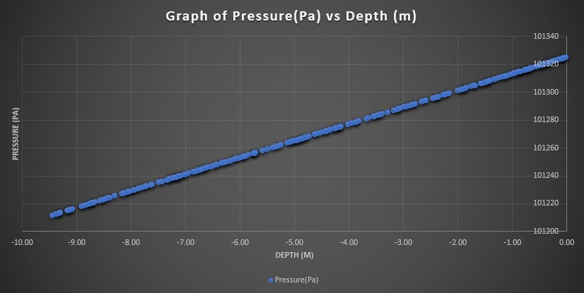
Analysis AND DISCUSSION – 2nd prototype
The second prototype was able to travel along the vertical axis of water and is able to collect, process and save data and create a webserver which is capable of transmitting this data autonomously to an external collecting device.
Reading N.O. | Distance travelled (±0.25)m | Time taken (±0.01)s
1 | 9.12 | 26.63
2 | 8.89 | 26.31
3 | 9.05 | 26.60
4 | 8.97 | 26.40
5 | 9.02 | 26.48
Graph of Pressure (Pa) vs Depth (m)
The average velocity of the balloon in the upwards direction is (0.340±0.009)ms⁻¹
Notes:
Speak of the international barometric formula and that is used by the Arduino for the BMP180 and how its resembled when looking at the readings in the graph

Slide 15
Analysis AND DISCUSSION – 2nd prototype
Amplitude = 44330(1-(P/P₀)^{1/5.255})
Equation 1: International Barometric Formula
Here,
P = Measured pressure in (hPa)
P₀ ₌ Pressure at sea level in (hPa)
Notes:
Speak of the international barometric formula and that is used by the Arduino for the BMP180 and how its resembled when looking at the readings in the graph

Slide 16
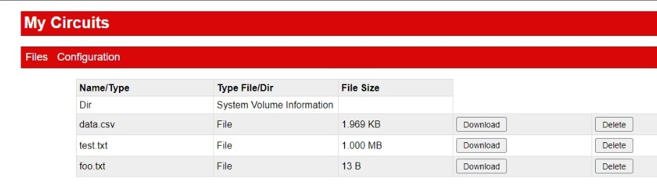
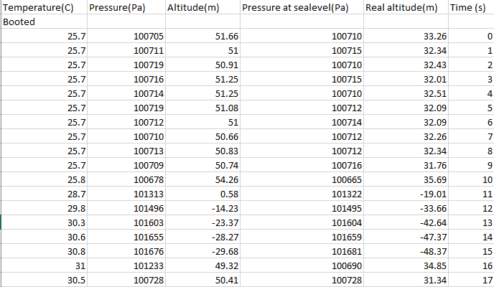
Analysis AND DISCUSSION – 2nd prototype
Internal Web server created by the Esp-32 module
Readings seen on Data.csv file
Notes:
Explain about the download button that acts as a flag to reset the Arduino module
Explain the data is deleted every time the Arduino module is reset. To save memory space

Slide 17
Conclusions
Principle of Up thrust was successfully used to float and submerge the inflation device for data collection and dissemination as required
Principle used
Data Collection and Processing
Data was successfully collected from the attached sensor , processed and saved using the ESP-32 module.
Data was successfully transmitted via the WIFI network to the remote collecting device.
Data Transmission
Limitations
The depth to which the inflation system can dive down to is limited by the components used in it’s creation.
Overall
The inflation system operates successfully and achieves the objectives it was meant to reach.

Slide 18
Future Work
Addition of motors to the inflation system so that the device can navigate in the water body and remain in the specified zone.
Creation of a troubleshooting system which can perform internal diagnostics on the system.
Creation of an inflating material that can be attached to the bottom of the inflation system and raise the entire system above the water.
Using the Wi-Fi bandwidth of 5 GHz in data transmission with the aid of antennas for further reach.

Slide 19
References
[1] Underwater Robotic Vehicles (ROV AUV) for Inspections, Observation and Videography.
[2] An Introduction to 5GHz Technology, 2021.
[3] Can Water Interfere With WiFi Signals? Exploring The Science Behind WiFi and Water Interactions, 2023.
[4] First Underwater Robot. http://www.seasky.org/ocean-exploration/ocean-timeline-1951-1970.htm
[5] S. Aronica, N. Gabriele Gall`ı, Bernardo Patti, I. Fontana, P. Calandrino, G. Giacalone, G. Basilone, S. Mazzola, and A. Bonanno. The autonomous underwater data acquisition system for physical and chemical parameters (AUDAS-PCP) onboard a fishing vessel. Journal of Operational Oceanography, 9:s58–s65, jun 2016
[6] Daniel Babatunde, Simon Pomeroy, Paul Lepper, Ben Clark, and Rebecca Walker. Autonomous deployment of underwater acoustic monitoring devices using an unmanned aerial vehicle: The flying hydrophone. Sensors (Switzerland), 20(21):1–21, nov 2020.

Slide 20
Thank you!

